Slide 1



NATIONAL INSTITUTE OF TECHNOLOGY, WARANGAL
DEPARTMENT OF COMPUTER SCIENCE ENGINEERING
DBMS PROJECT
VACCINATION DATABASE MANAGEMENT SYSTEM
GROUP MEMBER
SHIVAM PRATAP SINGH(21CSB0A69) HARSH VARDHAN(21CSB0A21)
FACULTY
DR.T.RAMAKRISHNUDU
PROFESSOR, DEPARTMENT OF CSE

Slide 2
Problem Statement:
The goal of this project is to design and implement a database management system for tracking vaccinations. The system should be able to store and manage information on individuals receiving vaccinations, including their personal details such as name, age, contact information, and medical history. It should also include information on the type of vaccine administered, the date of administration, and any relevant medical information such as allergies or adverse reactions.
The system should be user-friendly and allow authorised healthcare professionals to input and access data easily. It should also provide real-time updates on vaccination coverage and trends, enabling decision-makers to make informed decisions about resource allocation and public health initiatives.
Additionally, the system should be secure, with appropriate measures in place to protect sensitive data from unauthorized access or breaches. It should comply with relevant data protection and privacy regulations and adhere to ethical principles governing the collection and use of personal information.
Overall, the vaccination database management system should be a reliable, eﬃcient, and secure tool for tracking and managing vaccinations, supporting public health eﬀorts to improve population health outcomes.

Slide 3
Assumptions:
•
A vaccine supplier can supply multiple hospitals with vaccines and Hospitals can receive vaccines from multiple suppliers thus M:N relationship between the two entities.
•
A vaccination center receives vaccines through multiple inventories keepings track of vaccines available at a center hence there is 1:M relationship between the entities.
•
A hospital supplies the vaccines to multiple inventories.
•
A hospital has multiple health workers available for vaccination drives at vaccination center.
•
A citizen can have multiple vaccination records depending on the number of vaccines he has taken.
•
A health worker can give multiple vaccines to patients.
•
The health worker is a citizen of India thus part of citizen table too.
•
A supplier can export vaccines to multiple countries.

Slide 4
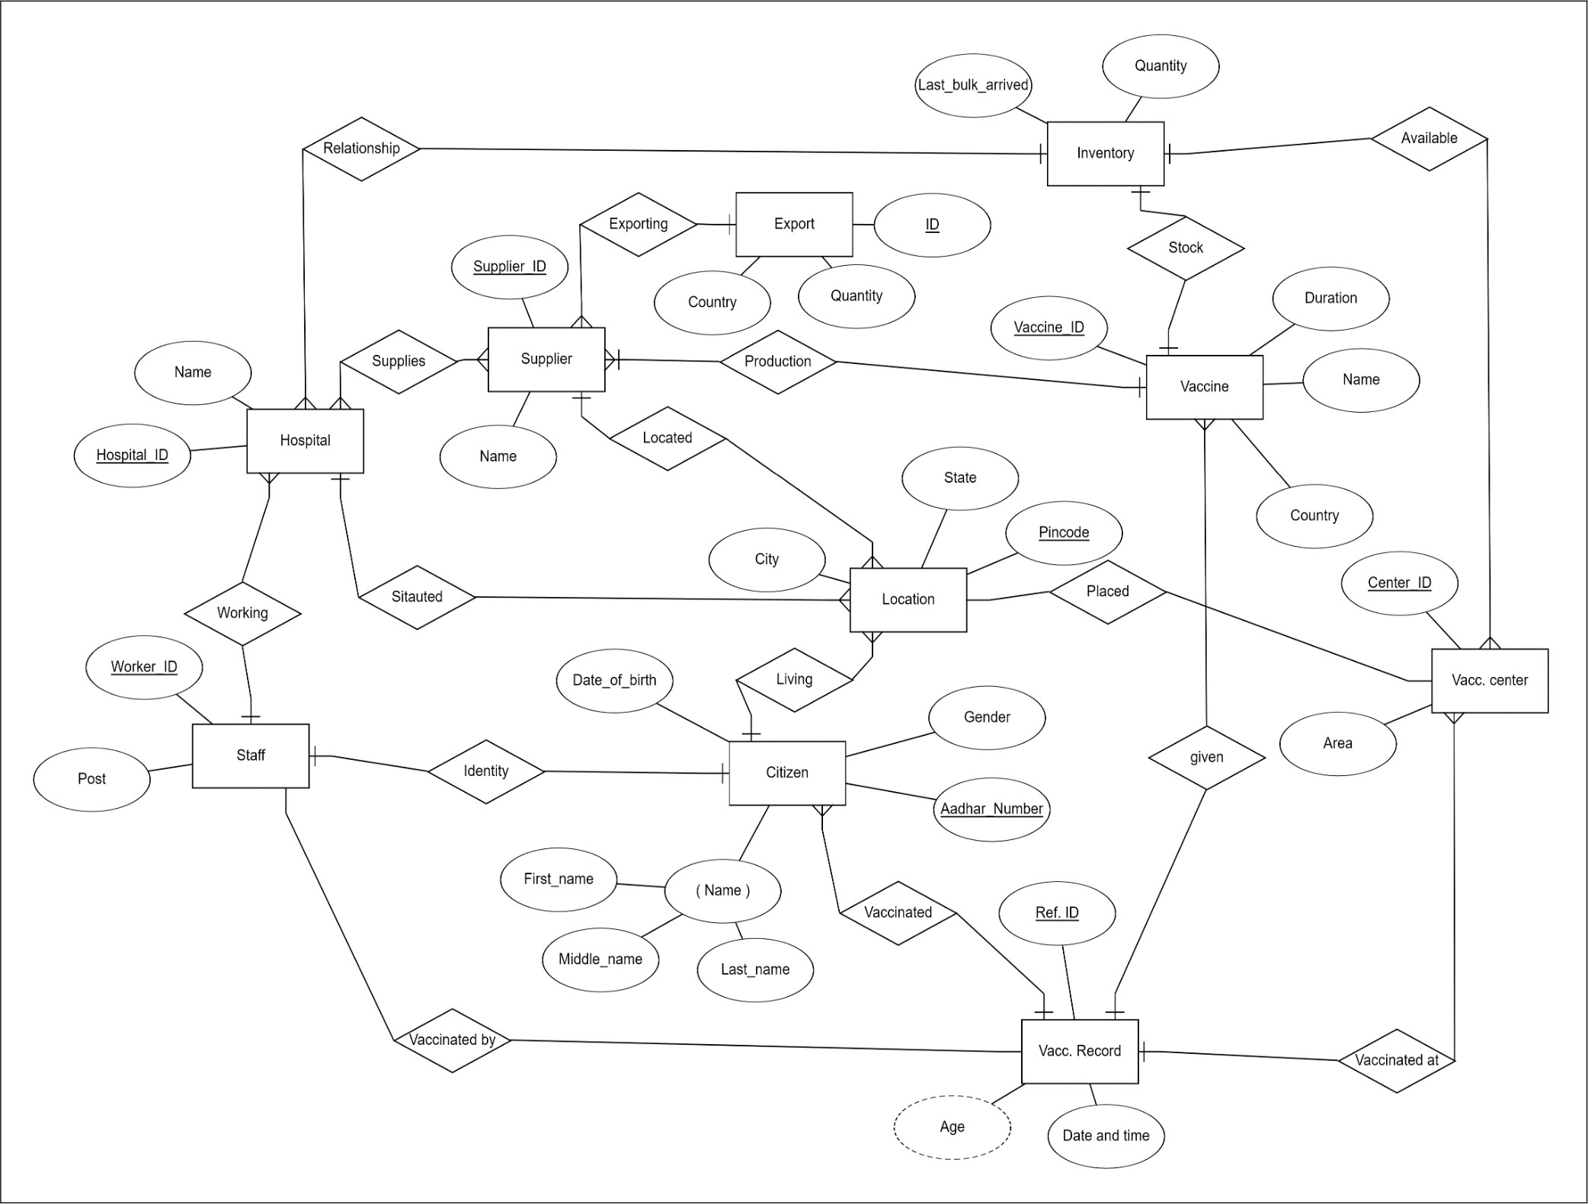
Entity Relationship (ER) Diagram

Slide 5
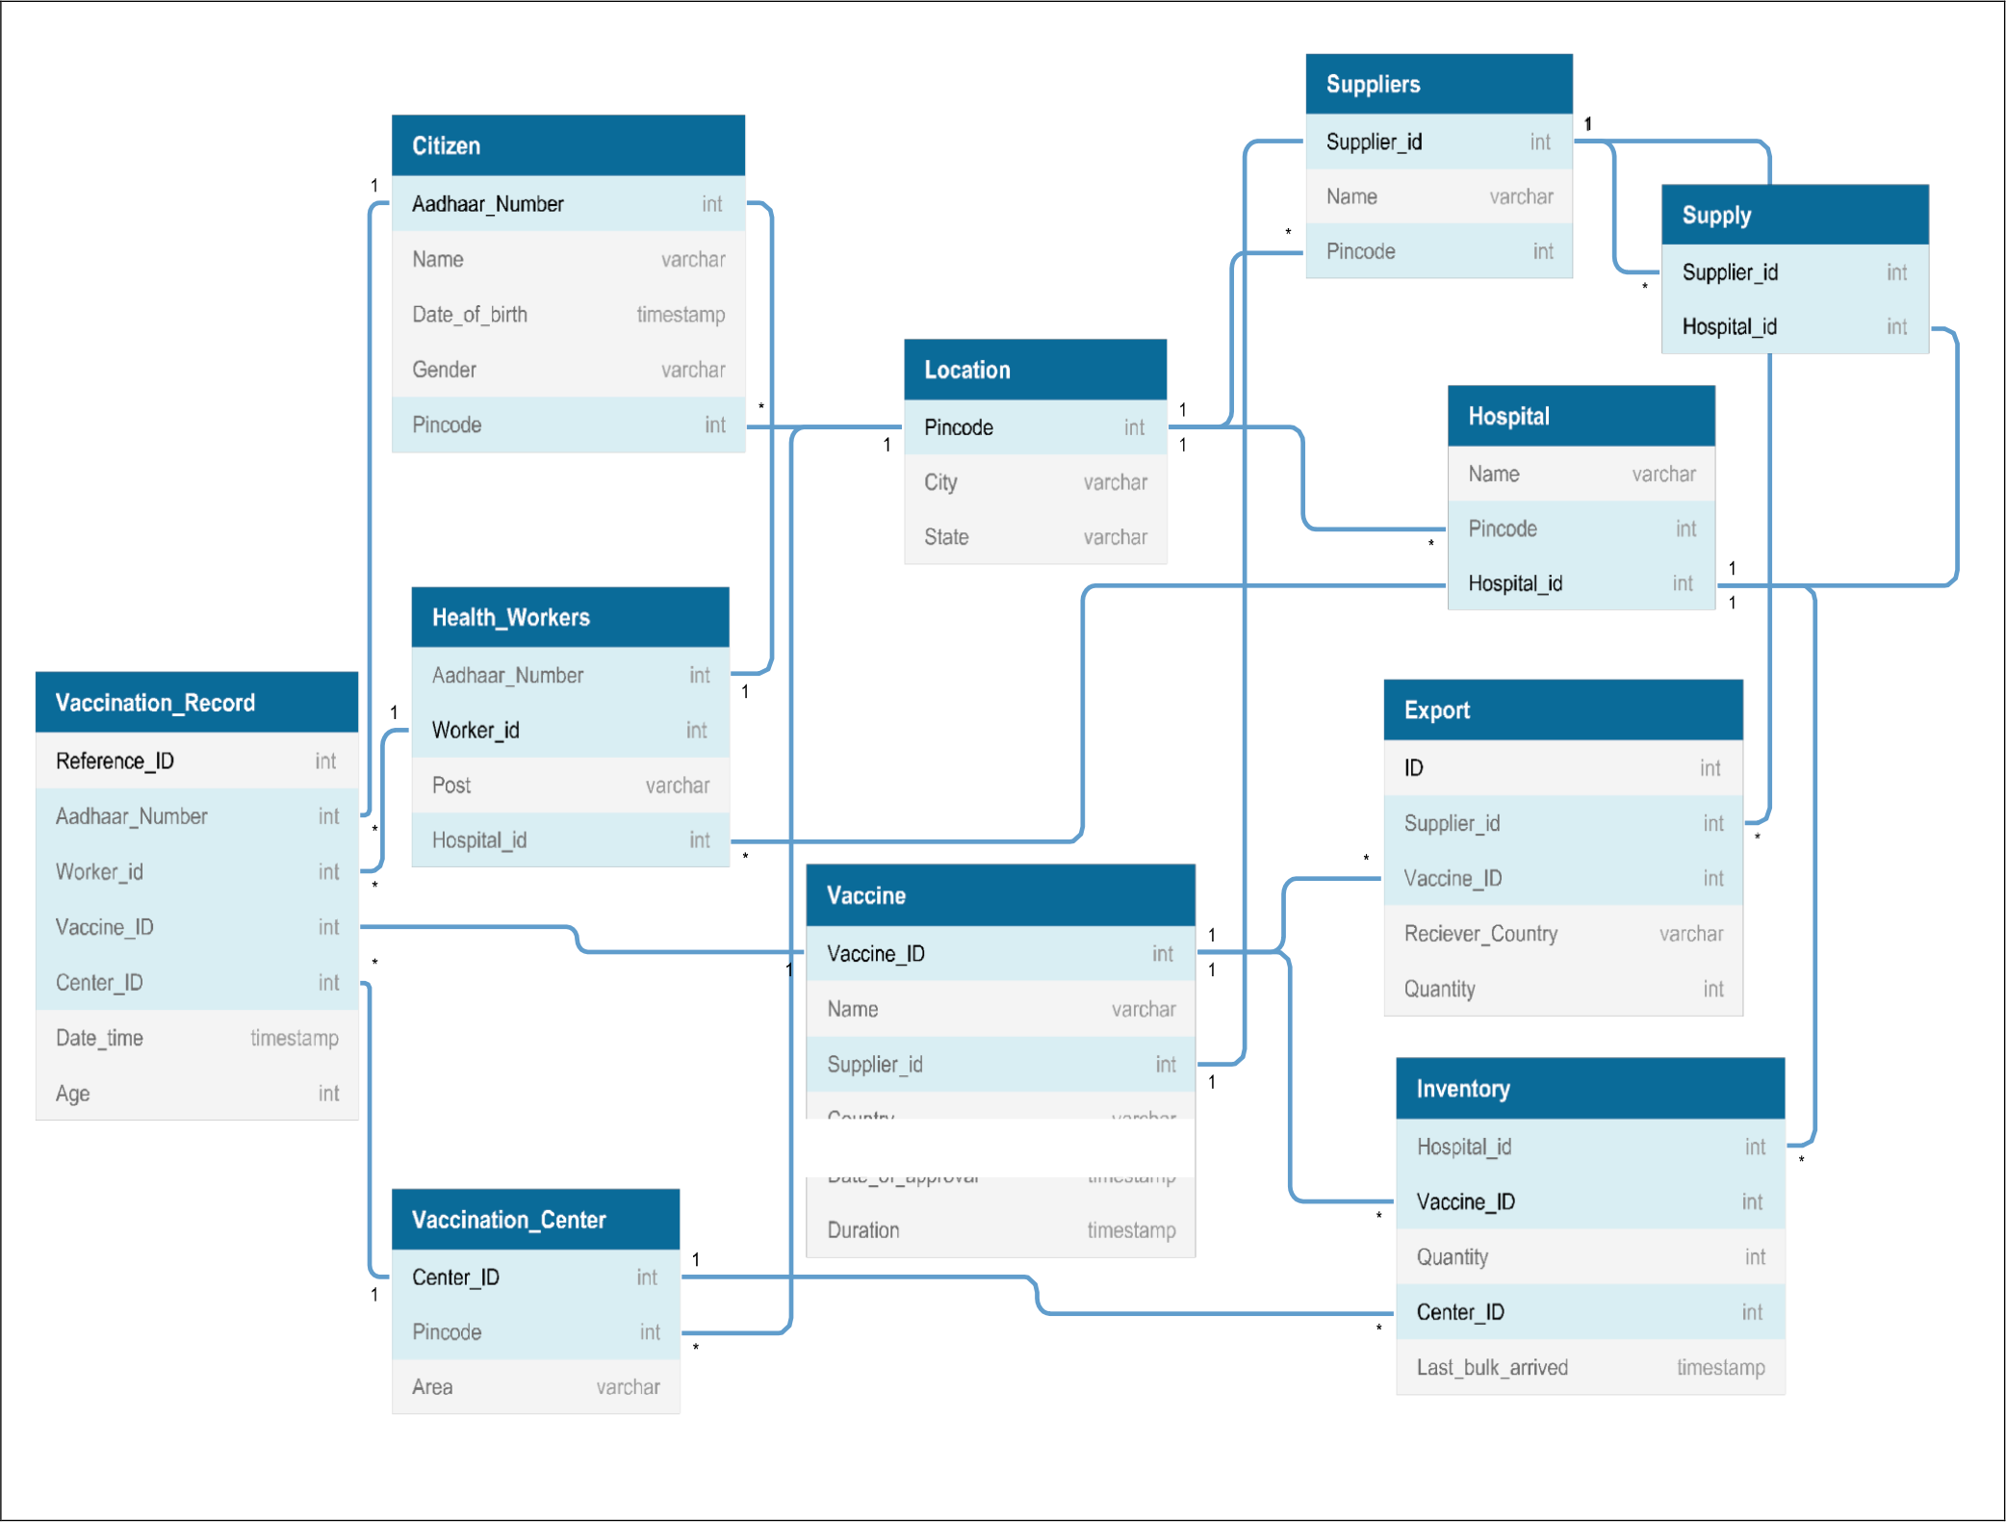
RELATIONAL MODEL

